Slide 1
Discrete Random Variables: PMFs and Moments
Lemon Chapter 2
Intro to Probability 2.1-2.5

Slide 2
Basic Concepts
Random Variable:
Every outcome has a value (number) for its probability
Can be discrete or continuous values
More than one random variable may be assigned to the same sample space
e.g. GPA and height of students
5 tosses of a coin: number of heads is random variable
Two rolls of die: sum of two rolls, number of sixes in two rolls, second roll raised to the fifth power
Transmission of a message: time to transmit, number of error symbols, delay to receive message
Notation:
Random variable: X
Numerical value: x

Slide 3
Probability Mass Function (PMF)
“Probability law”, or “probability distribution” of X (the random variable)
$$p_{x}\left(x\right)=P\left(\left\{X=x\right\}\right)$$
Example: two independent tosses of a fair coin, X is number of heads
$$p_{x}\left(x\right)=\left\{\begin{aligned}1/4, if x=0 or x=2 \\ 1/2, if x=1 \\ 0, otherwise\end{aligned}\right.$$
This is the probability that X = x
How to Calculate PMF of random variable (for each possible value x)
Collect all possible outcomes that give rise to the event (X = x)
Add their probabilities to obtain p_{x}(x)

Slide 4
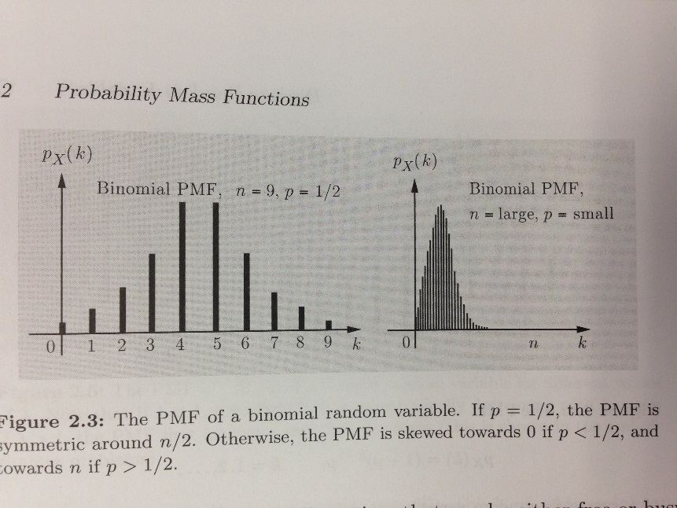
More About Random Variables
Bernoulli
Binomial
Usually used with two outcomes
Toss of a coin with probability of H is p and T is 1 – p
$$X=\left\{\begin{aligned}1, if a head \\ 0, if a tail\end{aligned}\right.$$
$$PMF=\left\{\begin{aligned}p, if k=1 \\ 1−p, if k=0\end{aligned}\right.$$
Used to model generic situations:
If a telephone is free or busy
A person can be either healthy or sick with a certain disease
Someone is either for or against a certain political candidate
A combination of multiple Bernoulli random variables
A coin tossed n times, with same probability independent of prior tosses
$$p_{x}\left(k\right)=P\left(X=k\right)=\left({n \atop k}\right)p^{k}{\left(1−p\right)}^{n−k}, k=0, 1,…, n$$

Slide 5
More About Random Variables
Geometric
Poisson
The number X of tosses needed for a head to come up for the first time
$$p_{x}\left(k\right)={\left(1−p\right)}^{k−1}p, k=1, 2,…$$
k signifies the total number of tosses, with k – 1 successive tails
Similar to a binomial variable, with very small p and very large n
Let X be number of typos in a book with total of n words
p is the probability of any one word to be misspelled (very small)
The number of cars involved in accidents in a city on a given day
$$p_{x}\left(k\right)=e^{−λ}\frac{λ^{k}}{k!}, k=0, 1, 2,…$$

Slide 6
Functions of Random Variables
Transformations of given random variable, X, to give other random variables, Y
e.g. X is today’s temperature in degrees Celsius
Can find Y (temperature in Fahrenheit from transformation of X)
$$Y=g\left(X\right)=1.8X+32$$
In this example, g(x) is a linear function of X, but g(x) may also be a non-linear function

Slide 7
Moments: Expectation, Mean, and Variance
First Moment: Expectation (also called mean)
Center of gravity of PMF
Weighted average in large number of repetitions of the experiment
A single representative number
Expected value:
$$E\left[X\right]=\sum_{x}{xp_{X}(x)}$$
$$E\left[g(X)\right]=\sum_{x}{g(x)p_{X}(x)}$$
Second Moment: Variance
$$var\left(X\right)=E\left[{\left(X−E\left[X\right]\right)}^{2}\right]=E\left[X^{2}\right]−{\left(E\left[X\right]\right)}^{2}$$
A measure of the dispersion of X around its mean
Another way of measuring this is standard deviation, square root of variance
Example 2.8 (pg. 91)
Also, skewness, kurtosis (dimensionless shape factors—third and fourth moment about the mean)

Slide 8
Joint PMFs
Combination of multiple random variables associated with the same experiment
Example 2.9 (pp. 93-95)
This process can be extended to more than two random variables

