Slide 1
Nuclear Power:
Status, Issues and Prospects
James F. Jackson

Slide 2
Nuclear Power Advantages
Carbon free base-load (24/7) power—reliable and expandable
Centuries of domestic fuel — no mining for 100 yrs using advanced fuel cycle
Very small fuel and waste volumes

Slide 3
Nuclear Power Challenges
High capital costs and long construction times ( ≈ $12 B and 9 years for Plant Vogtle)
Radioactive waste disposal
Concern over serious accidents like TMI
Reactors and nuclear weapons involve similar materials (non-proliferation)

Slide 4
Status of Nuclear Power
445 plants worldwide-- ≈10% of electricity
93 plants in U.S.-- ≈20% of electricity (license extensions completed on almost all)
50 new plants under construction worldwide, but only 2 are in the U.S. (China has 12)
≈ 30 plants cancelled in U.S. due to costs and cheap natural gas
Strong interest in small modular reactors (SMRs) to address cost and safety issues

Slide 5
U.S. Nuclear Plants

Slide 6
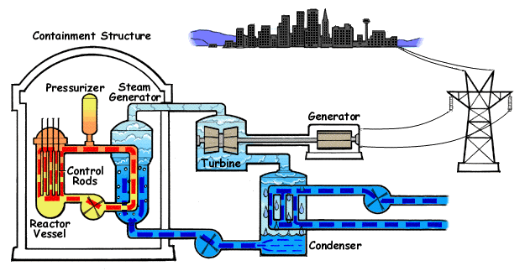
Pressurized Water Reactor

Slide 7
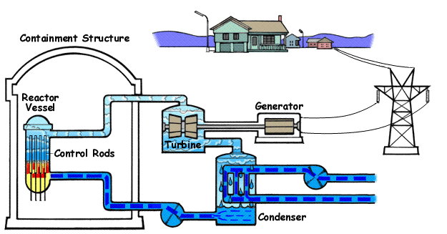
Boiling Water Reactor

Slide 8
Vogtle Plant: 2 Unit PWR

Slide 9
Vogtle Plant: Proposed Addition

Slide 10
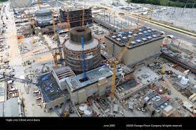
Vogtle Plant: AP 1000 (2021)

Slide 11
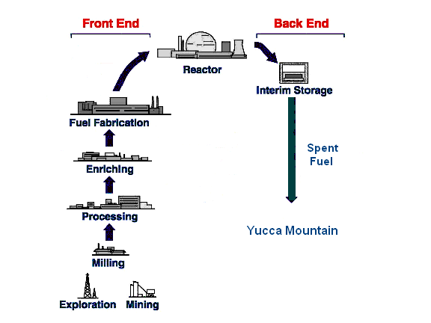
Current U.S. Fuel Cycle

Slide 12
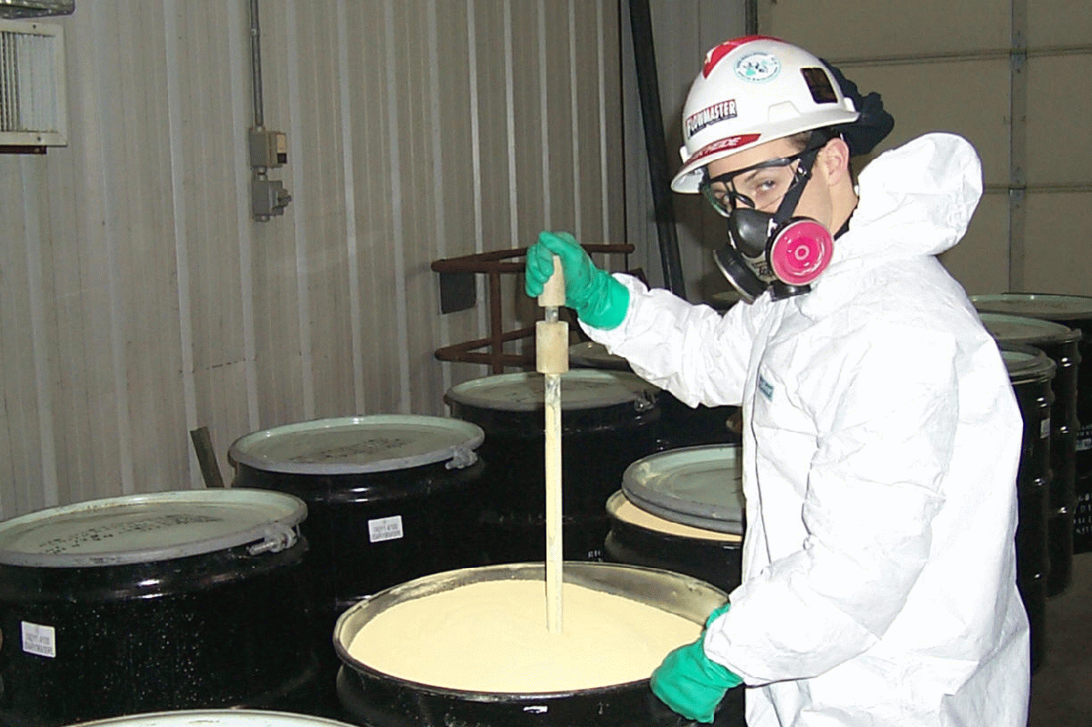
Yellowcake, U₃O₈ , is packaged into 55-gallon drums
at a uranium mill, and then shipped to a conversion plant

Slide 13
Uranium Conversion
Only operating U.S. plant in Metropolis, IL
Converts U₃O₈ (yellowcake) to UF₆
UF₆ sublimes at 134⁰F
Packaged into 10 to 14 ton cylinders
Allowed to cool 5 days to solidify
Shipped to enrichment plant

Slide 14
Properties of Natural Uranium
Natural uranium consists of three isotopes:
Isotope % Abundance Half Life (years)
²³⁸U 99.284 4.5 billion
²³⁵U* 0.711 704 million
²³⁴U 0.005 245 thousand
*Must be enriched up to about 3-5% for commercial fuel

Slide 15
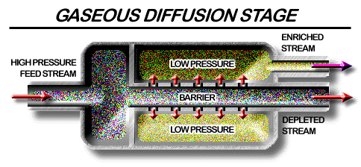
Gaseous Diffusion Enrichment
Flow of UF₆ through a single stage

Slide 16
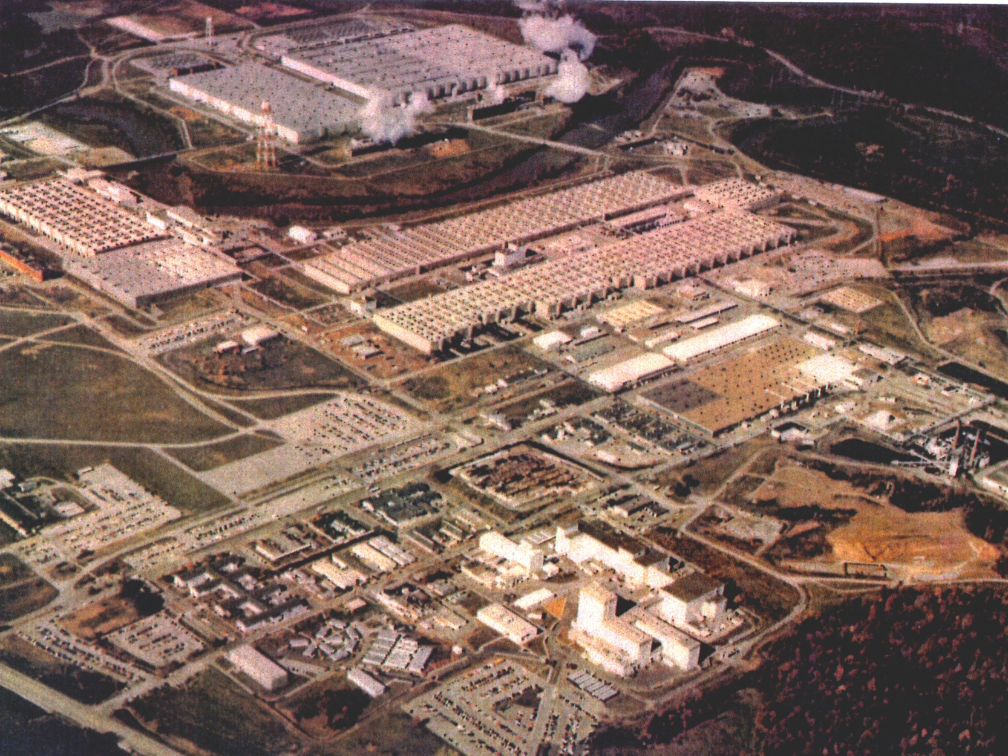
Oak Ridge Gaseous Diffusion Plant
K-25 Plant, Oak Ridge, in decommissioning since 1985
Notes:
Oak Ridge

Slide 17
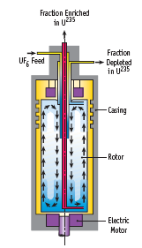
U Enrichment by
Gas Centrifuge

Slide 18
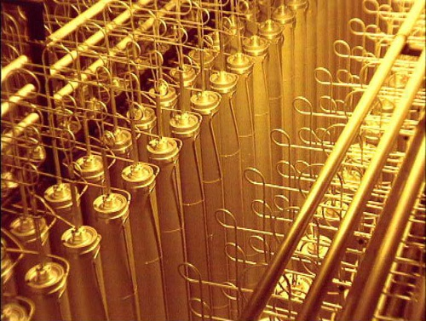
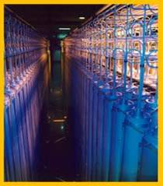
Views of a Urenco Gas Centrifuge Cascade

Slide 19
Laser Enrichment
Science developed in 70s at Los Alamos and Livermore Labs
Very high separation rates at each stage (not dependent on tiny U²³⁵/U²³⁸ mass difference)
Atomic Vapor (AVLIS)
Molecular UF₆ (MLIS)
Molecular UF₆ (SILEX)

Slide 20
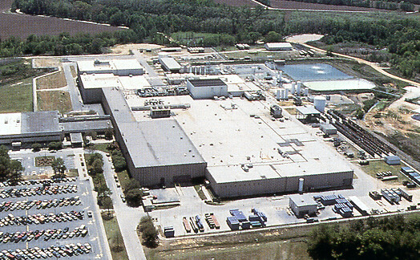
Westinghouse Fuel Fabrication Facility, South Carolina

Slide 21
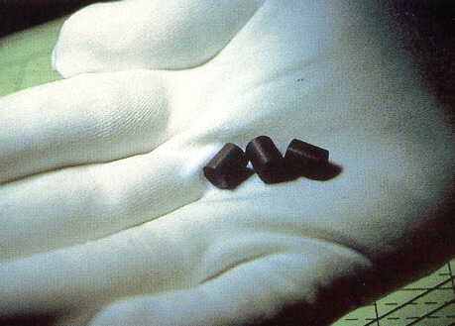
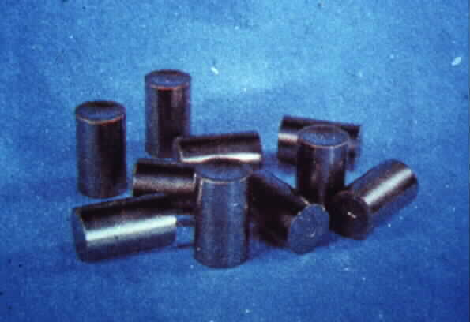
UO₂ pellets are about 0.5 in.
in length & 0.33 in.
in diameter.
They are "dished" slightly on each end to allow for thermal expansion.
Pellet Production

Slide 22
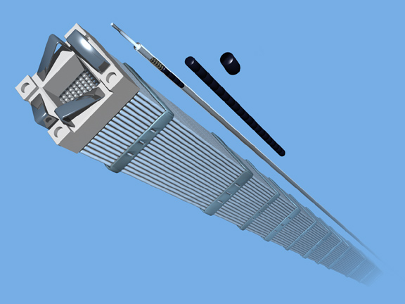
Fuel Rods Filled With Pellets Are Grouped Into Fuel Assemblies
Notes:
The pellets are sealed in metal fuel rods, 12 feet long and half an inch in diameter. Fuel rods are made of zirconium, which resists heat, radiation and corrosion. The rods are bundled together into fuel assemblies, which are placed inside the reactor.

Slide 25
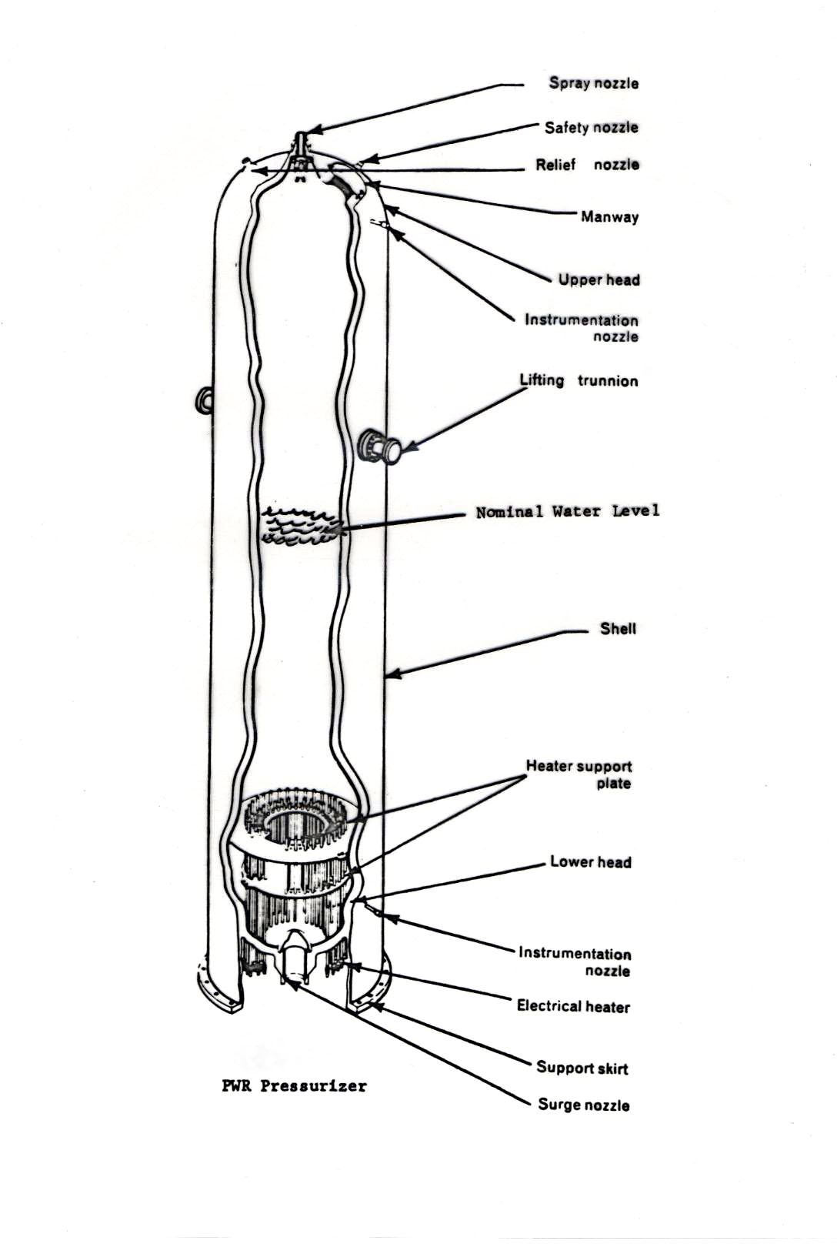
PWR Pressurizer

Slide 26
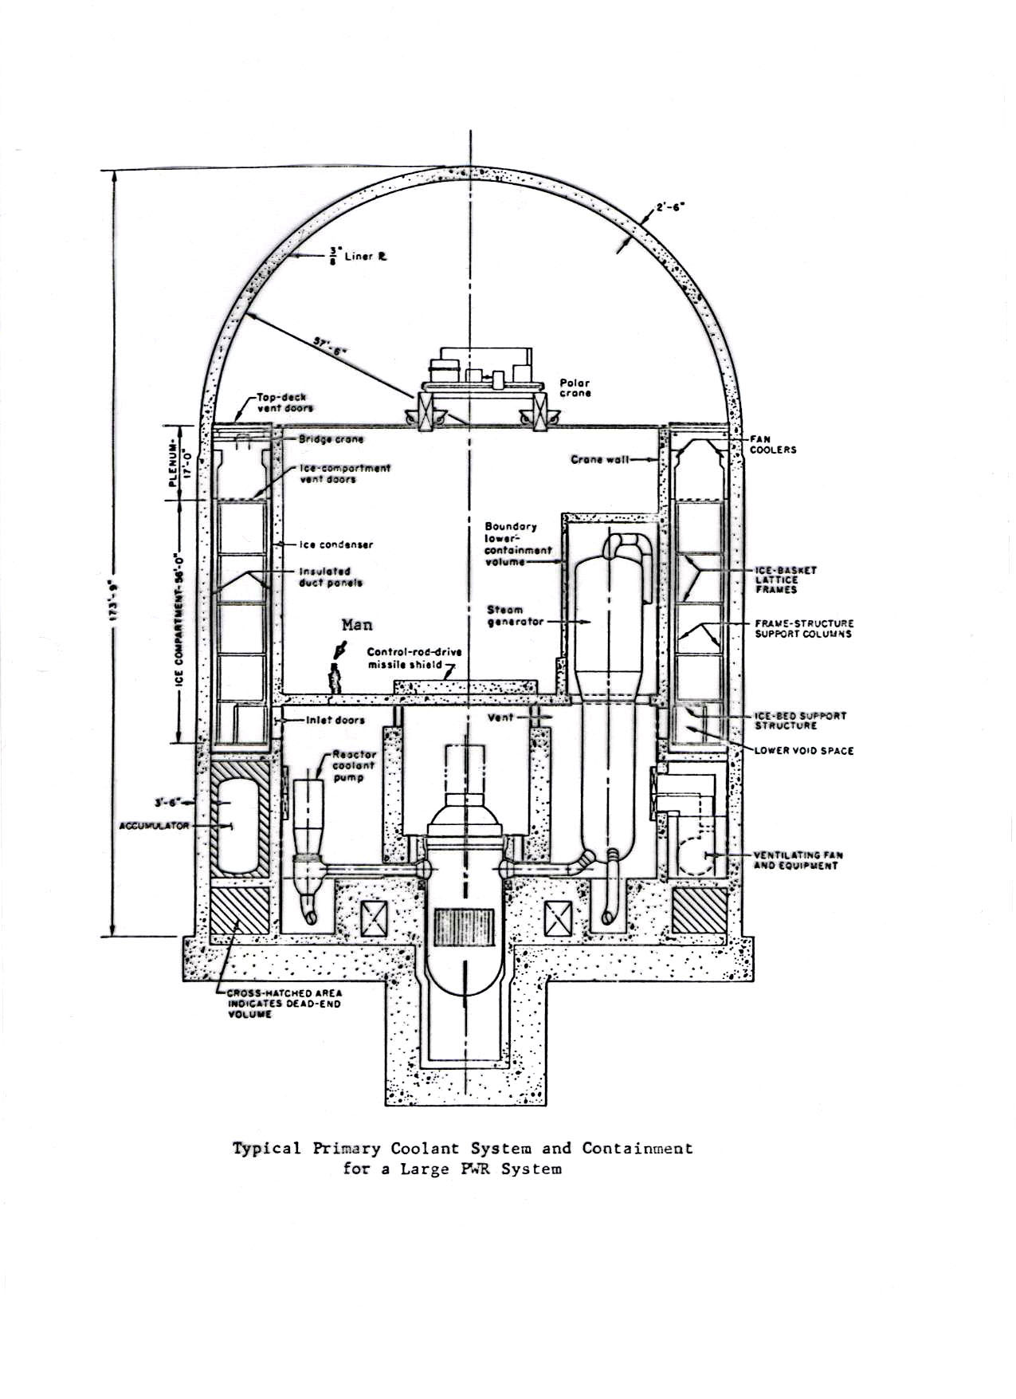

Slide 27
Nuclear Reactor Safety
Public fear of major accidents is one barrier to the expansion of nuclear power
Key issue: avoid any large releases of radioactive materials
Engineering challenge: never allow fuel rods to melt
  Mobilizes radioactive nuclides and produces hydrogen
Approach: Use passive and active safety systems to shut down the chain reaction and remove radioactive decay heat (long term)

Slide 28
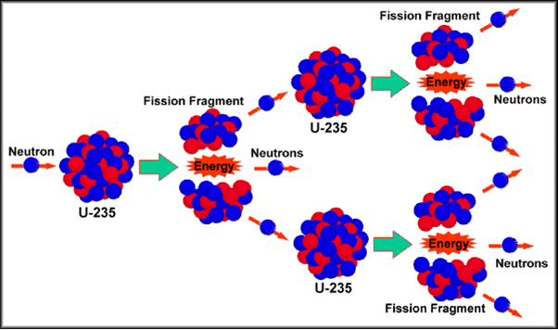
Uranium Fission Process

Slide 29
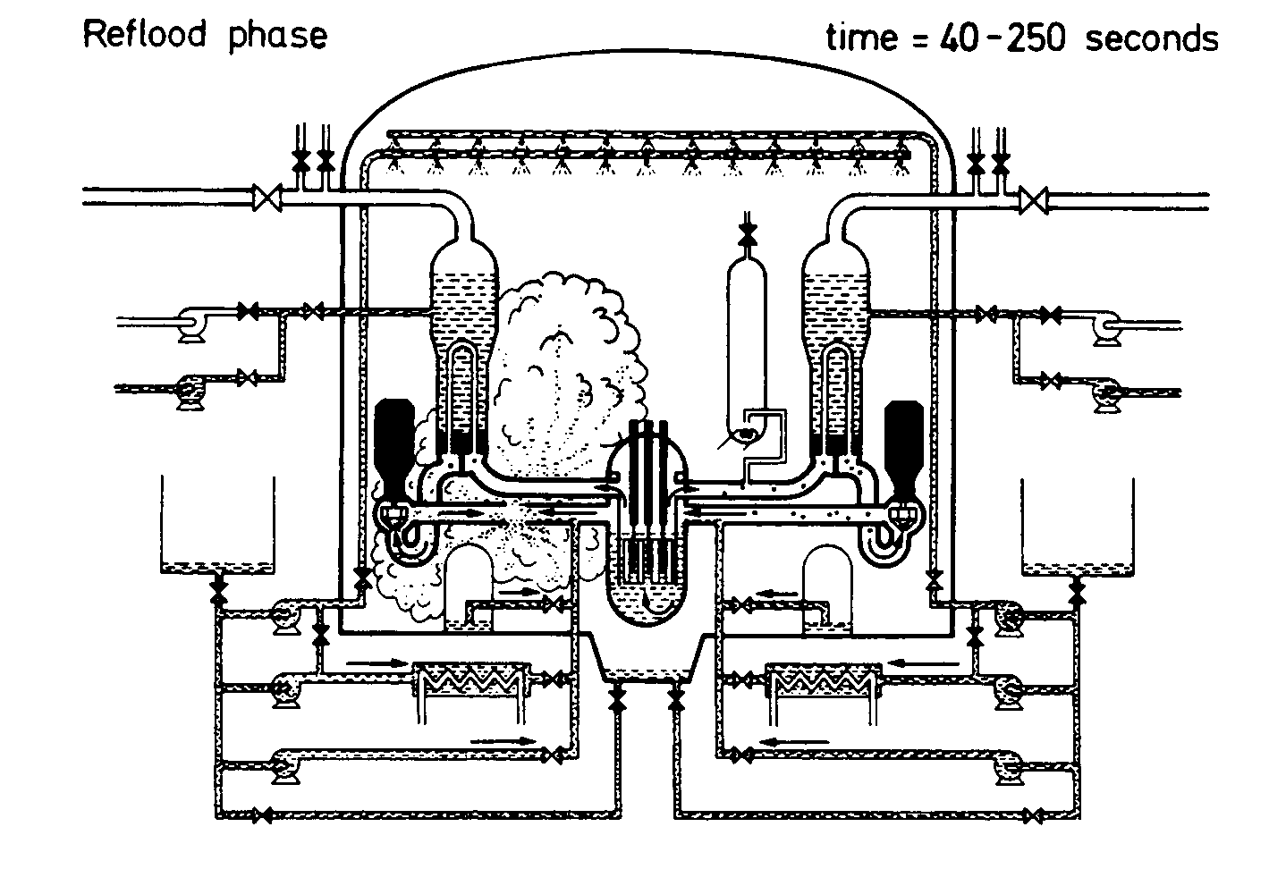
Large Break Loss of Coolant

Slide 30
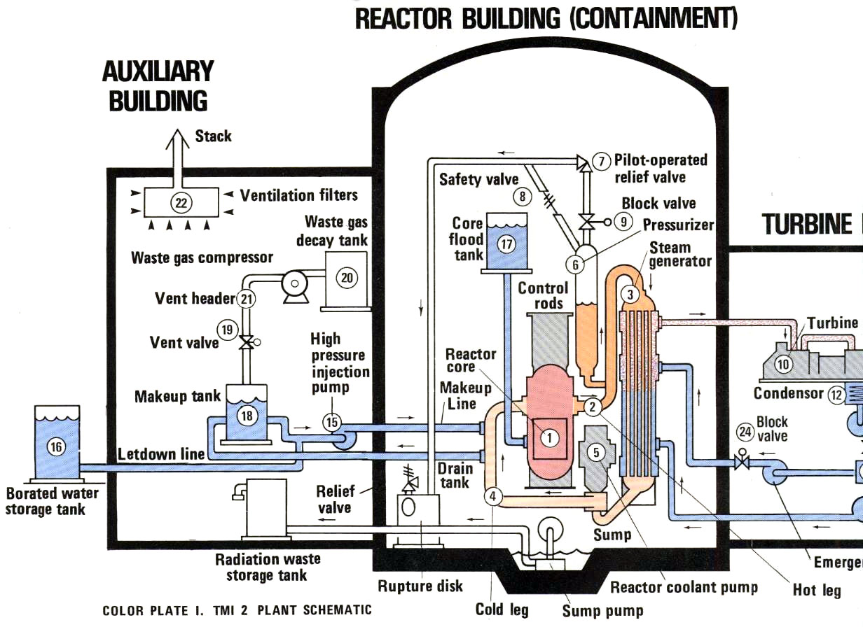
Three Mile Island Plant

Slide 31
Engineering Lessons Learned
Defense in depth critical – passive vs. active safeguards
Man-machine interface critical
Operators must be well trained to deal with a wide range of accident conditions
No substitute for operational experience
Need strong maintenance, inspections and lessons learned programs

Slide 32
Strong Record of Safe Operation
Improved operator training, facility maintenance, formality of operations, and lessons-learned programs since Three-Mile-Island accident
Strong oversight by the Nuclear Regulatory Commission
Precursor events dramatically reduced:
1985: 2.37 per reactor-year
1998: 0.04 per reactor-year
40 years of safe and reliable operation in U.S

Slide 33
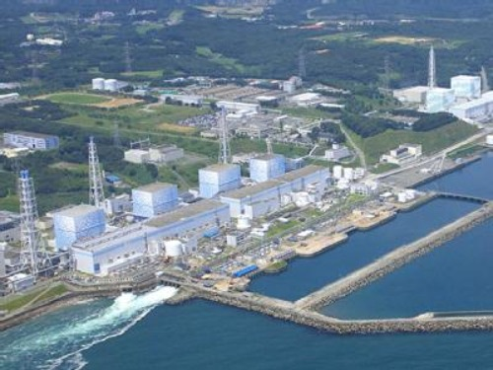
Fukushima Japan Nuclear Site
Four BWR Units

Slide 34
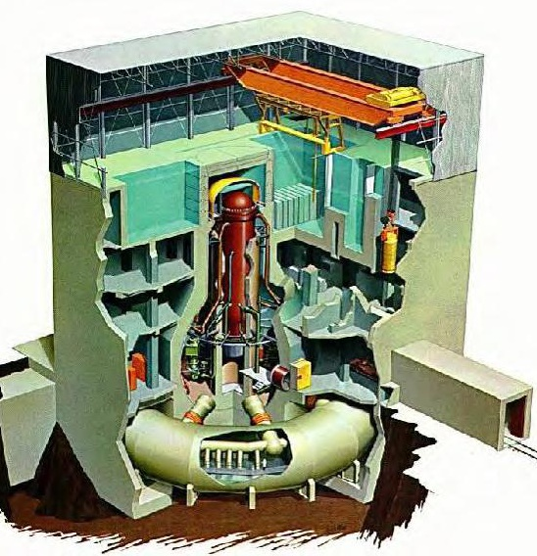
BWR Containment Structure

Slide 35
Fukushima Accident (March 11, 2011
Large earthquake leads to reactors shutting down and activating emergency systems
45 foot tsunami hits plants designed to tolerate a 18 foot tsunami
Plants lose all offsite and diesel backup power needed for emergency cooling pumps
Fuel rods melt in three reactors and one fuel storage pool, producing hydrogen
Hydrogen explosions severely damage the outer reactor structures

Slide 36
Fukushima Accident (contd.)
Damaged core material remains in reactor vessels
Radioactive material released, mostly in water that flowed into the ocean
Long term cooling eventually established
Projections indicate no one will be harmed by the released radioactive material, but people temporarily evacuated as a precausion

Slide 37
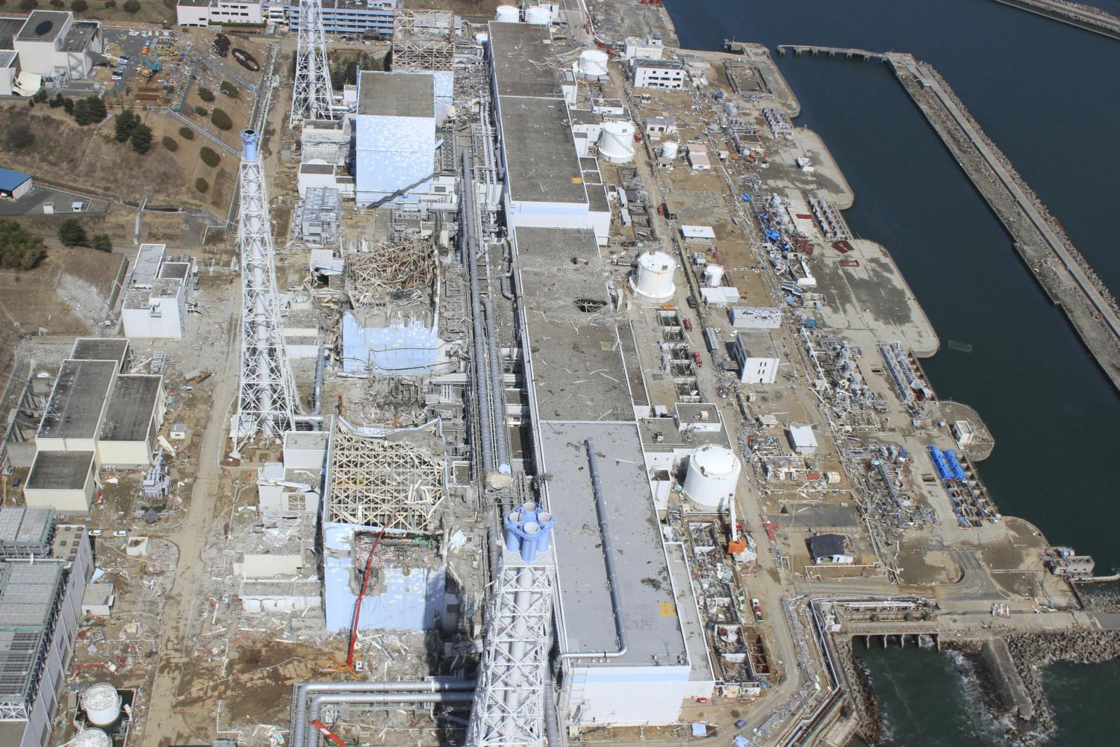
Fukushima Plants Post Accident

Slide 38
Impact of Fukushima Accident
Countries with a strong commitment to nuclear continued their plans (except Japan)
Some others, like Germany are planning to phase out their nuclear plants
All countries reviewed the lessons learned and ensured that external risks, such as earthquakes, were properly evaluated
Polls in U.S. indicate ongoing 50/50 support for nuclear (higher near existing plants)

Slide 39
“Yeah, but what about the waste?”
Near Term: Store used nuclear fuel assemblies
  Interim storage at plants
  Geologic storage (DOE responsible)
Long Term: Essentially “burn” all actinides using an advanced fuel cycle, and only store fission products
  Dramatically reduces waste volume and toxicity
  Extracts all energy from uranium resources

Slide 40
Uranium Fission Process

Slide 41
Nuclear Power Plants Produce Plutonium
Neutron U-238 Pu-239
Pu-239 fissions just like U-235
Pu-239 can then be used as a nuclear fuel, or in the production of nuclear weapons

Slide 42
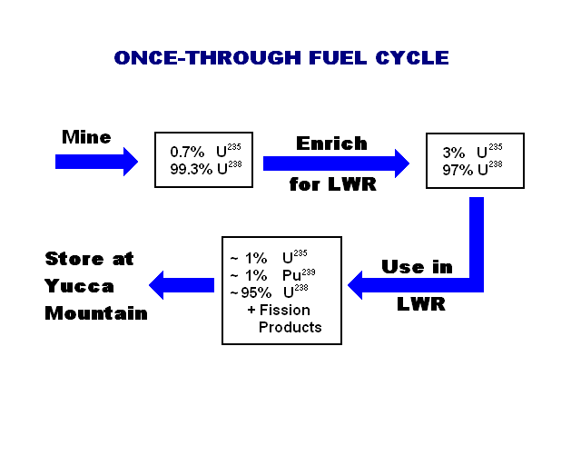

Slide 44
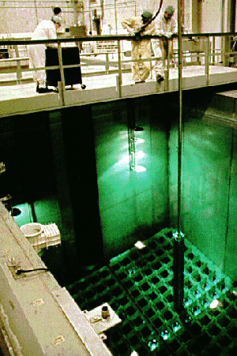

Slide 45
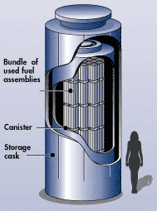
Reactor Site Storage Cask

Slide 46
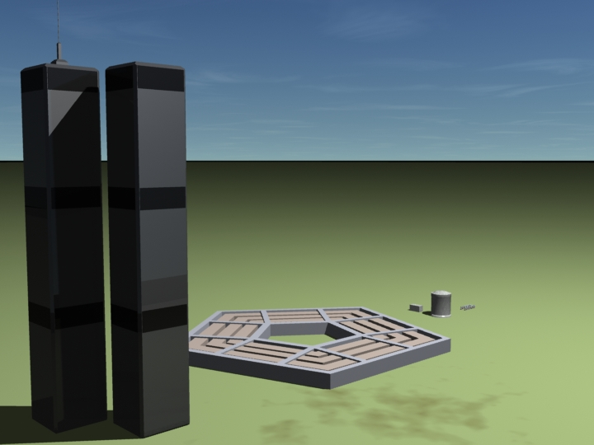
Comparative Size of Targets
WTC
208’ wide
1,353’ tall
Containment Building
130’ wide
160’ tall
Spent Fuel Pool
80’ wide
40’ tall
Dry Casks
10’ wide
20’ tall
(12 depicted)
Pentagon
1,489’ wide (921’ per side)
71’ tall

Slide 47
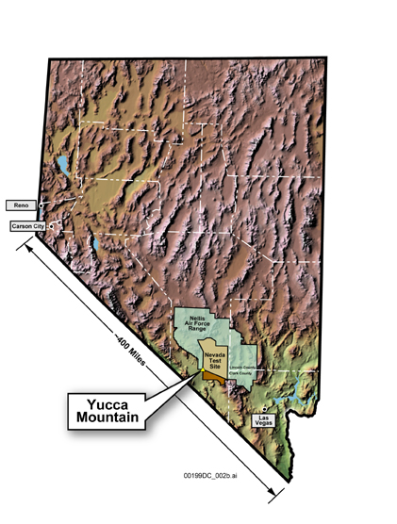
Yucca Mountain Site

Slide 48
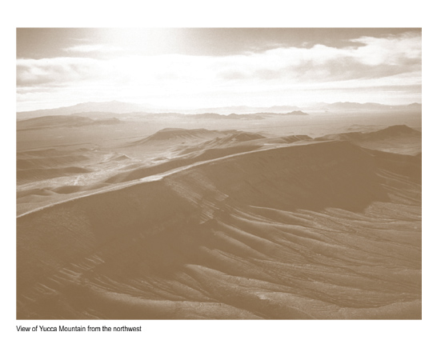
Yucca Mountain Site

Slide 49
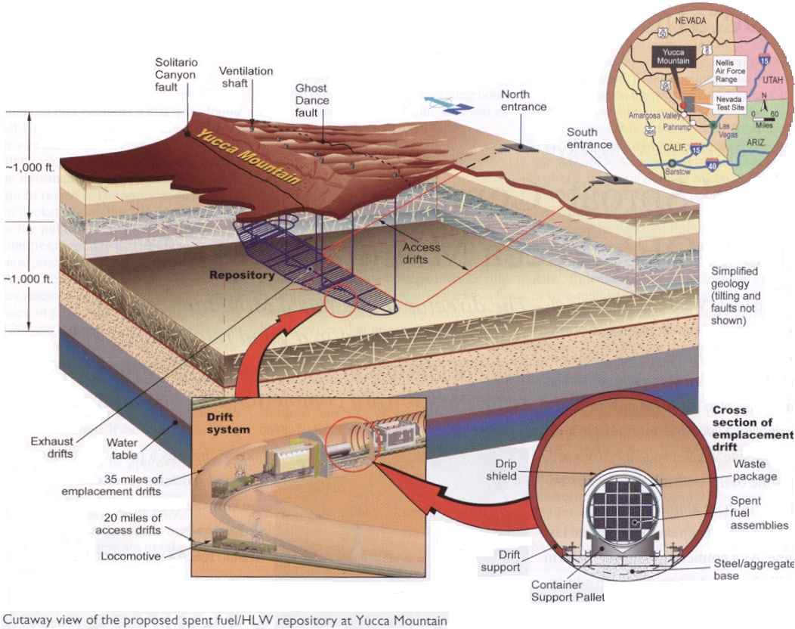

Slide 50
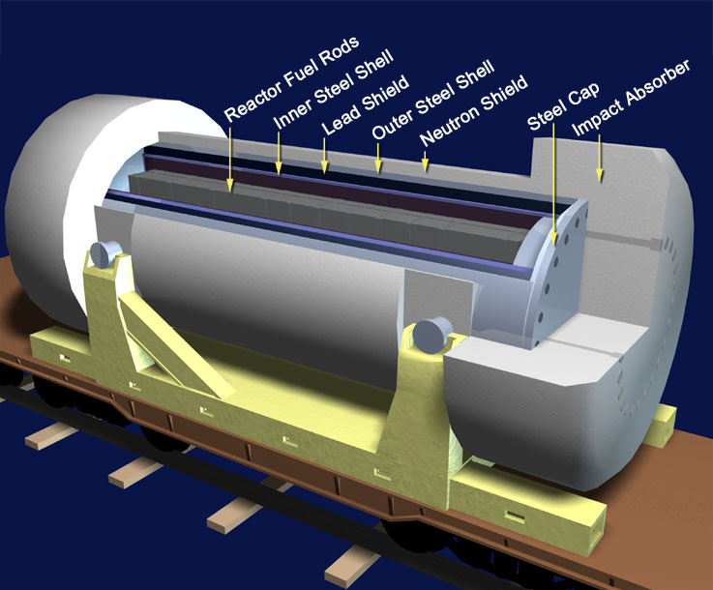
Shipping Cask

Slide 51
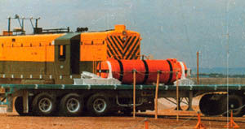
Shipping Cask Test with 80mph Locomotive

Slide 52
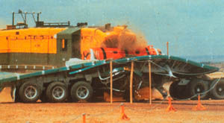
Locomotive Impacting the Shipping Cask

Slide 53
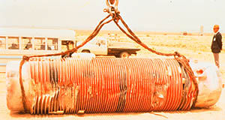
Shipping Cask after Test

Slide 54
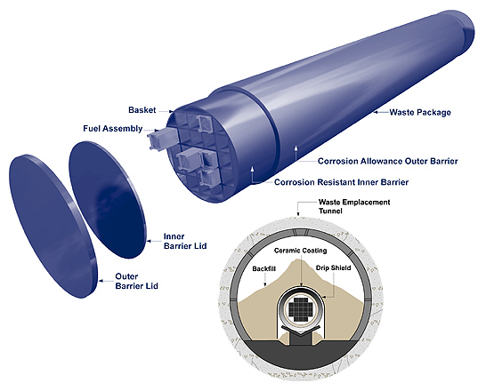
Spent Fuel Storage Canister

Slide 55
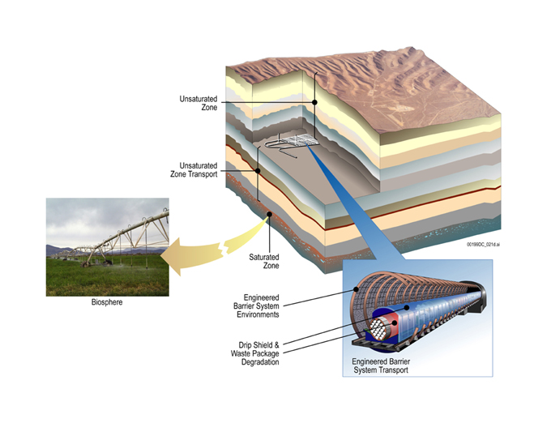
Engineered and Natural Barriers

Slide 56
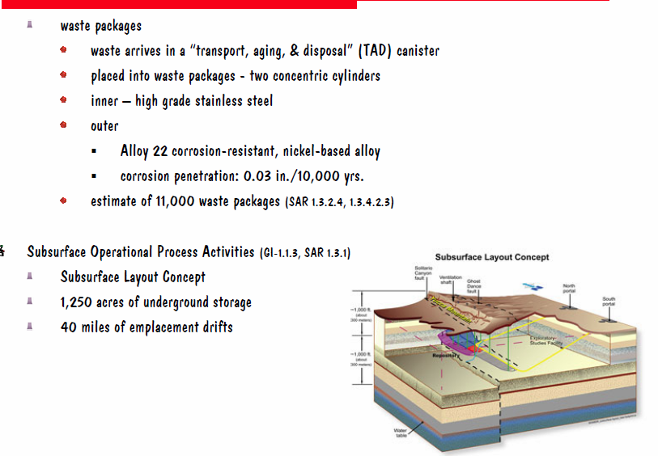

Slide 57
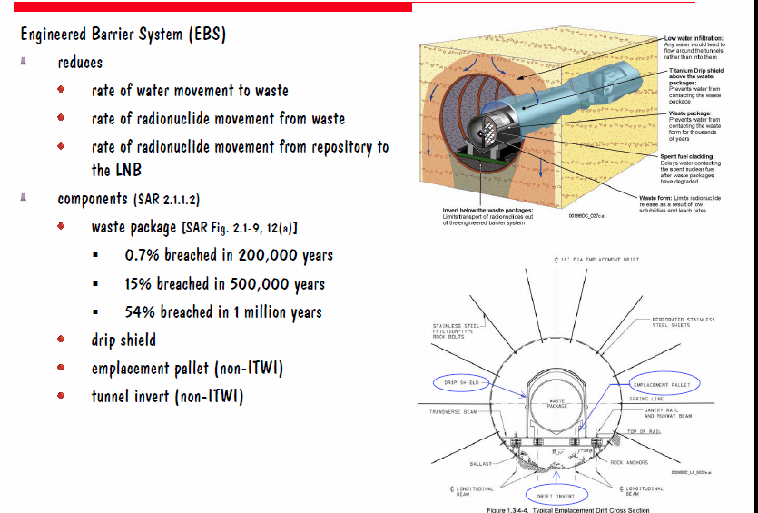
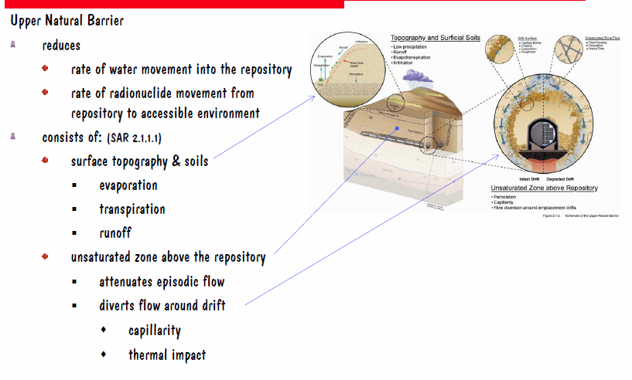

Slide 58
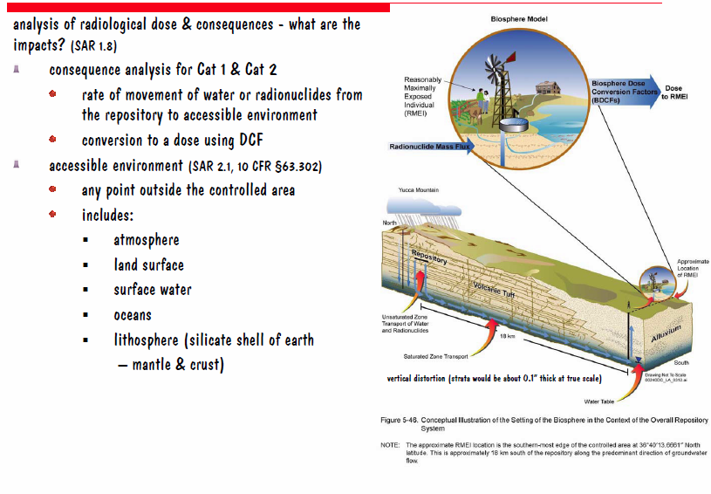

Slide 59
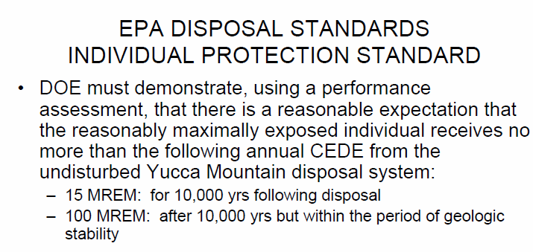

Slide 60
Yucca Mountain Calculated Doses from the DOE SAR
Max Annual Mean Dose during the first 10,000 years after closure: 0.24 mrem
Max Annual Median Dose during the first 1,000,000 years after closure: 0.96 mrem.
This max dose occurs at about 720,000 years after closure.

Slide 61
Current Status in the U.S.
Yucca Mountain project killed politically
Interim storage at reactor sites in dry casks (endorsed by the NRC)
By law, the DOE is still responsible for taking ownership and disposing of spent fuel
Still unsettled and very political

Slide 63
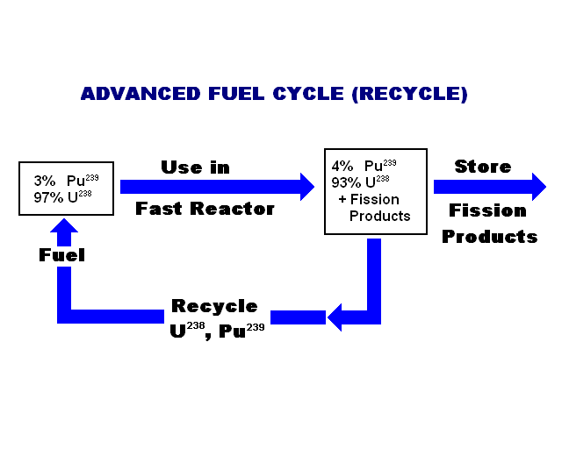

Slide 64
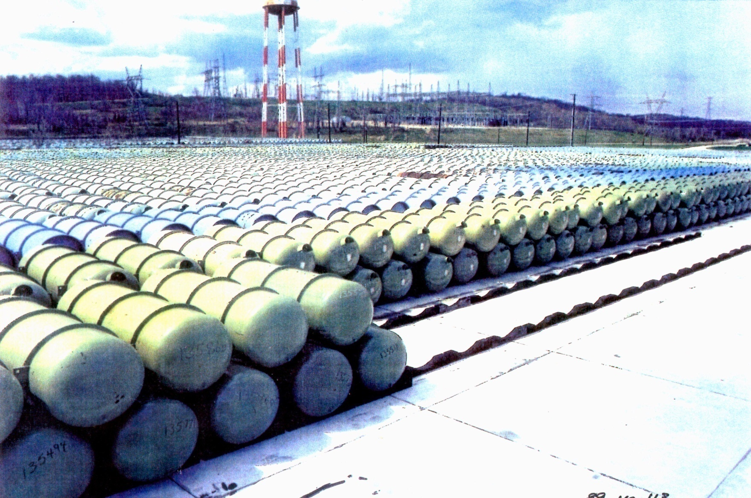
Depleted Uranium – Enrichment Tailings

Slide 65
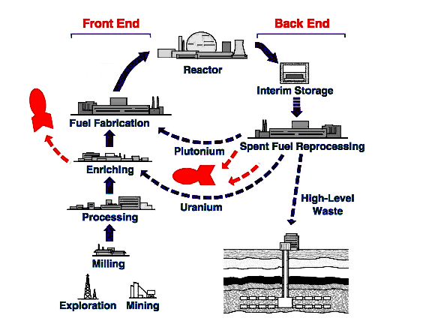
Complete Fuel Cycle

Slide 66
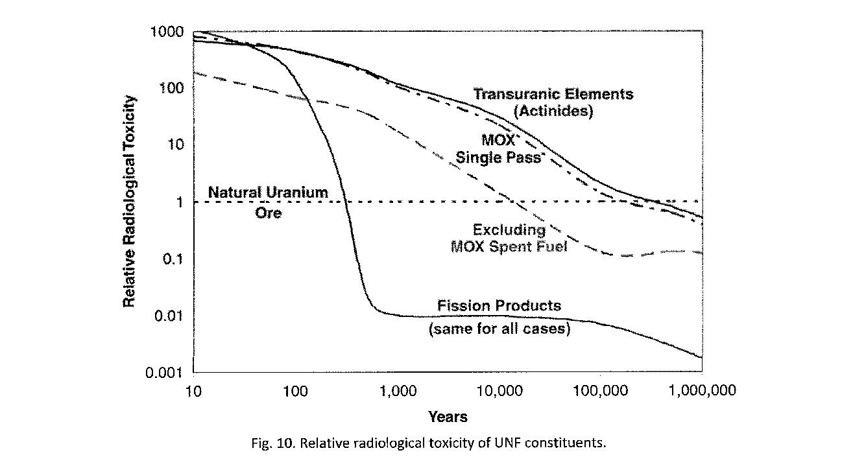
Toxicity of Used Nuclear Fuel Constituents

Slide 67
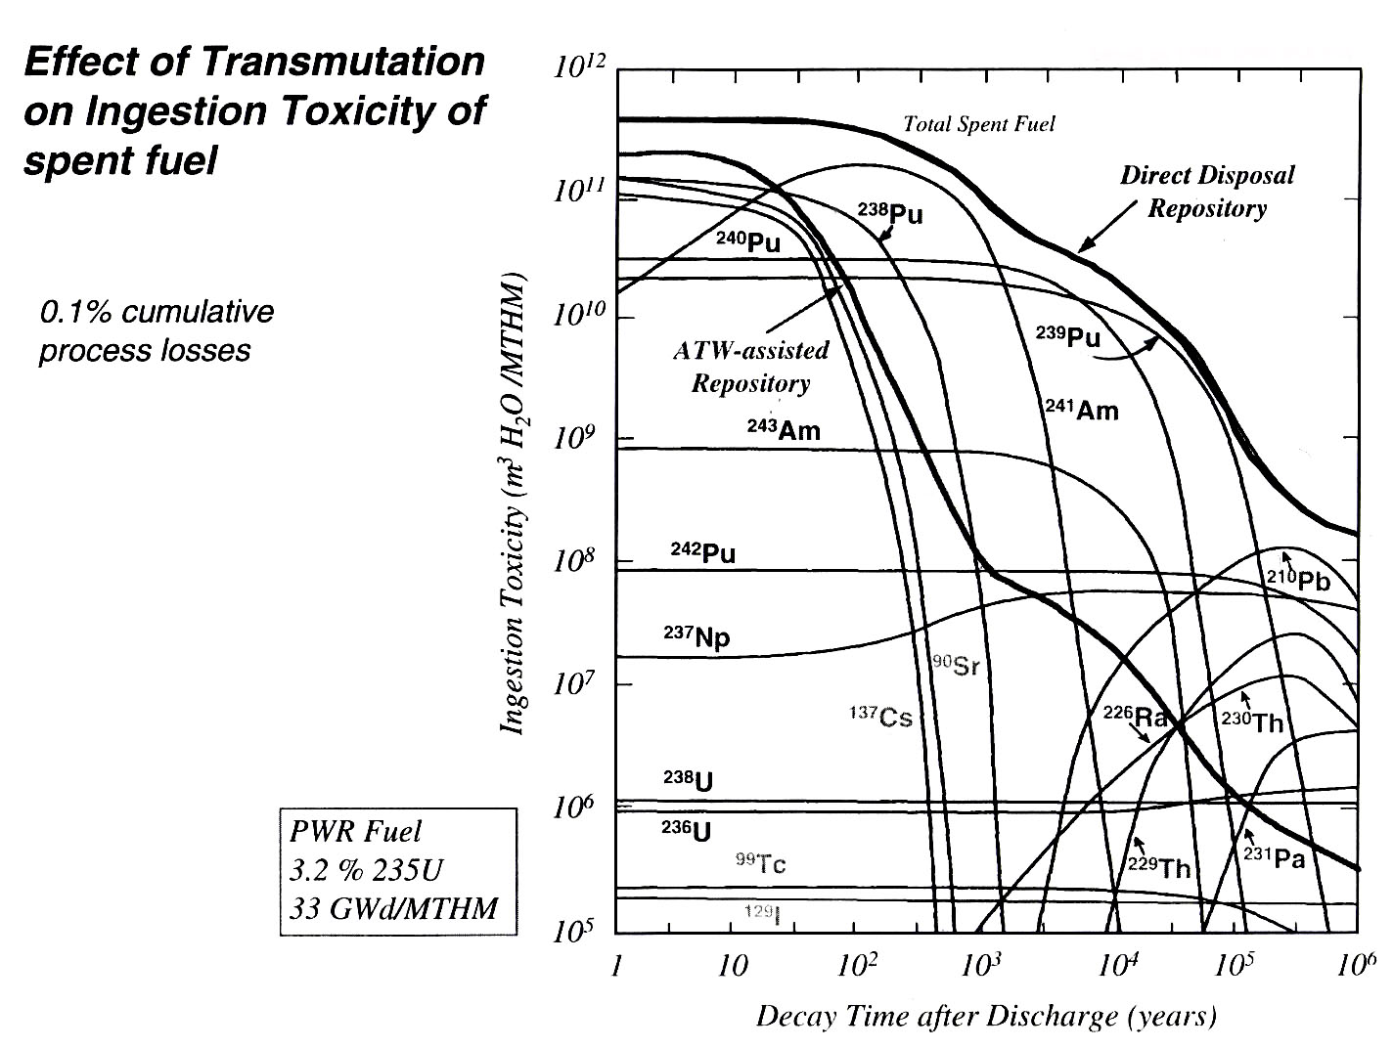

Slide 68
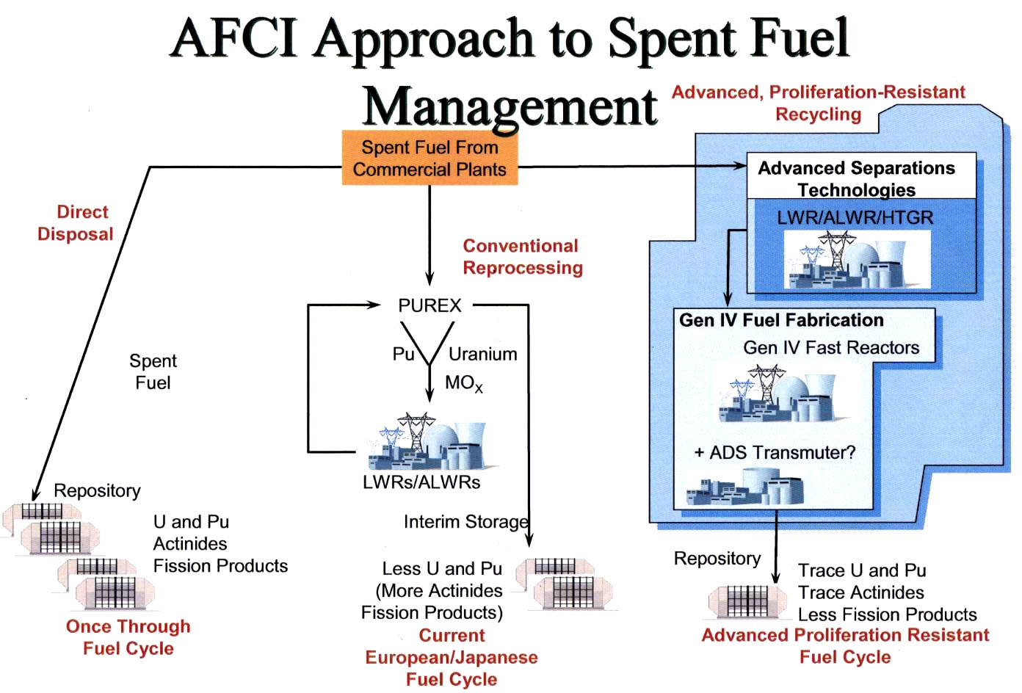

Slide 69
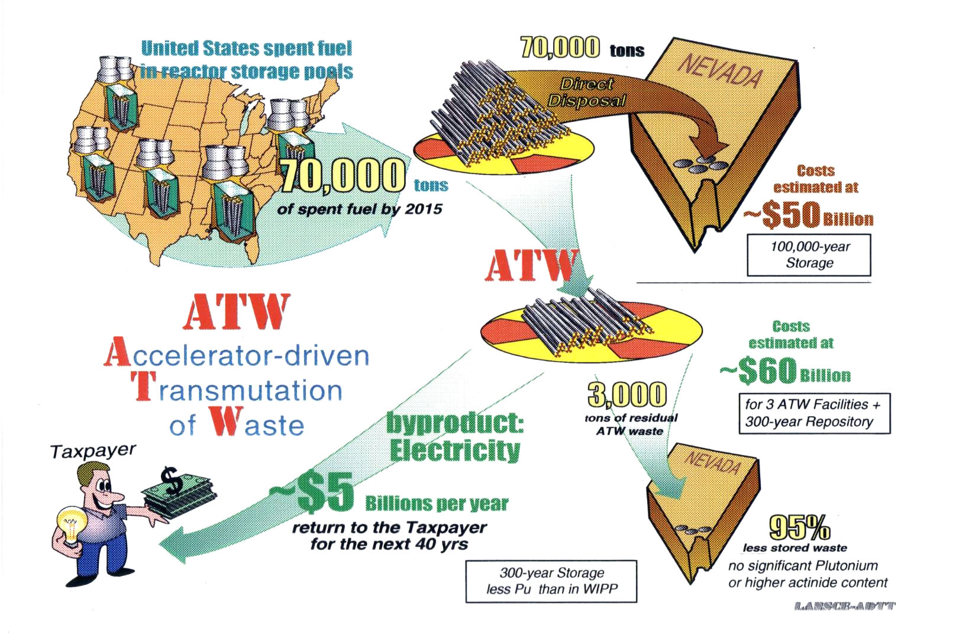

Slide 70
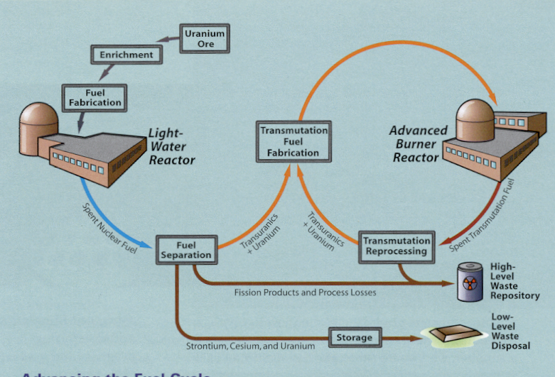
Advanced Fuel Cycle

Slide 71
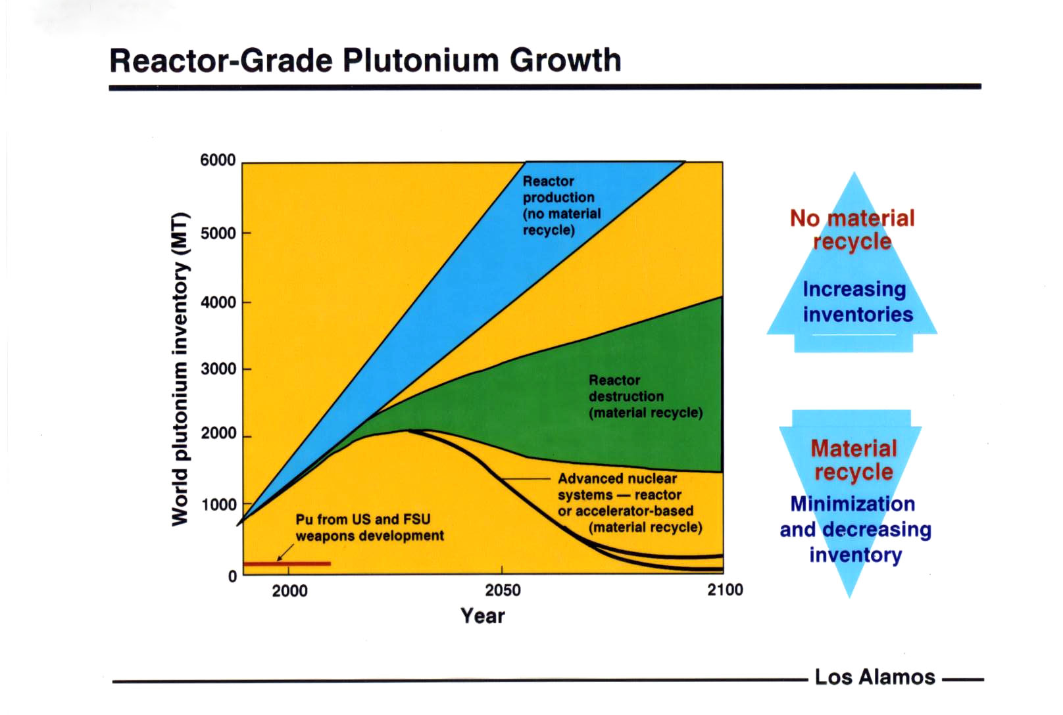

Slide 72
Nuclear Waste, Fuel Cycle and Reactor Options
Long-term viability requires fuel recycle to extend fuel resources and reduce waste volume and toxicity
Will still need a Yucca Mountain type repository to store wastes
Factory-built Small Modular Reactors with walk away safety hold real promise

Slide 73
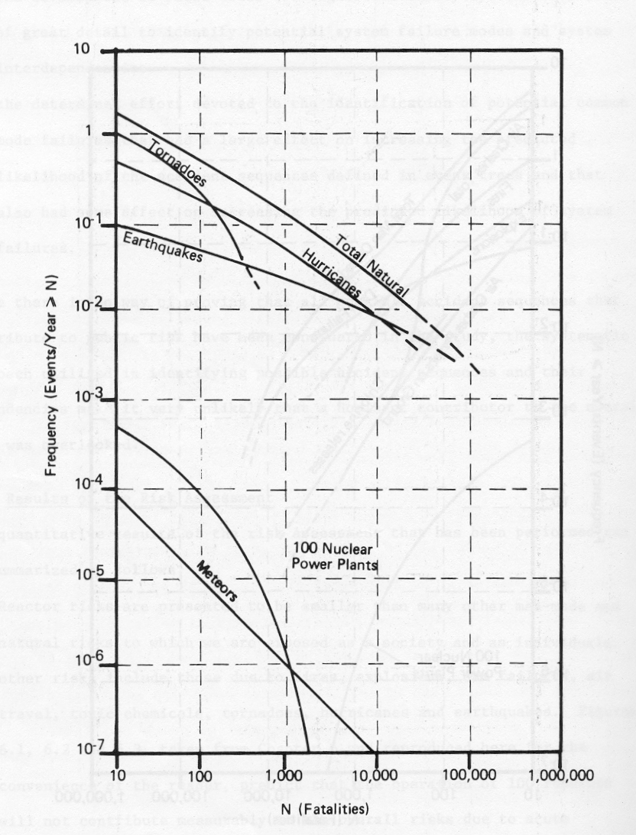
Natural Risks (WASH 1400)

Slide 74

Man-Caused Risks (WASH 1400)

