Slide 1
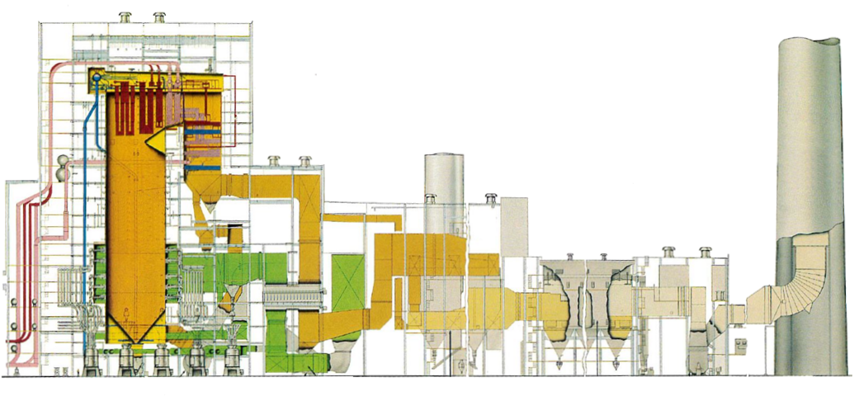
Reconfiguring a Plant for CO₂ Capture
Selective
Catalytic Reduction
Air
Low-NO_{x}
Burners
Wet Flue Gas
Desulfurization
Fabric Filter
or
Electrostatic
Precipitator
Coal

Slide 2





Biomass/Coal Co-firing in Utility Boilers
PacifiCorp STEP
Biomass
air
Pre-combustion
preparation
Coal
* Plant representation from Babcock & Wilcox – Steam, Its Generation and Use

Slide 3
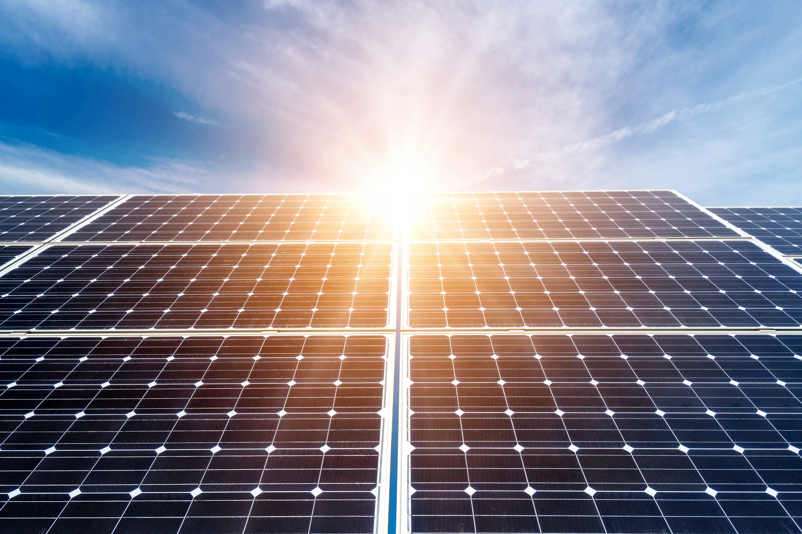
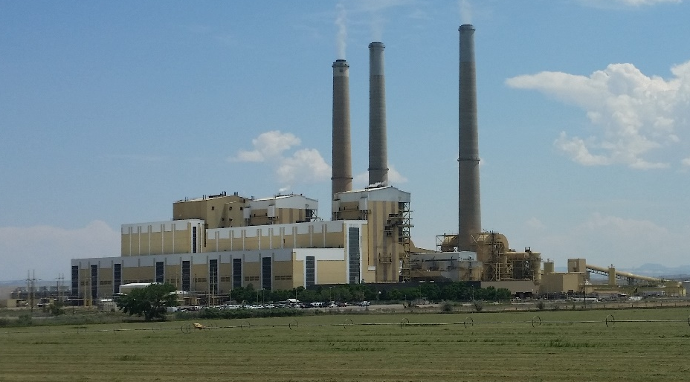
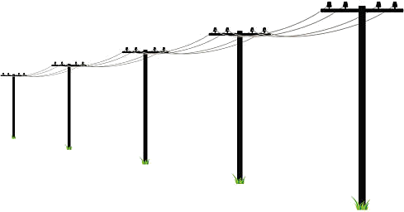
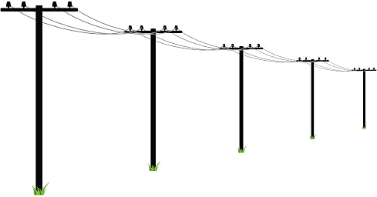

Coal Power Plant Dynamic Optimization
US Department of Energy
Get the Balance Right
Photovoltaic (Solar Cells)
Coal (Thermal) Power Plant
Cyclic Producer
Built for FSA
Power Consumer

Slide 4
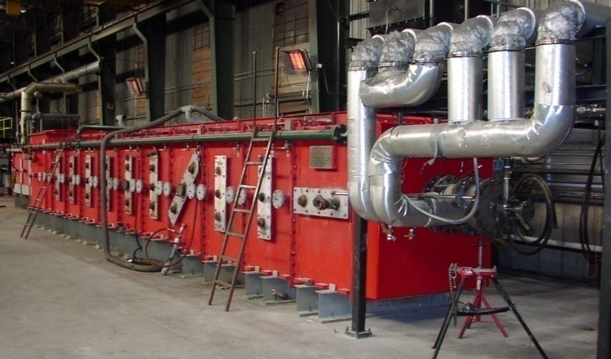
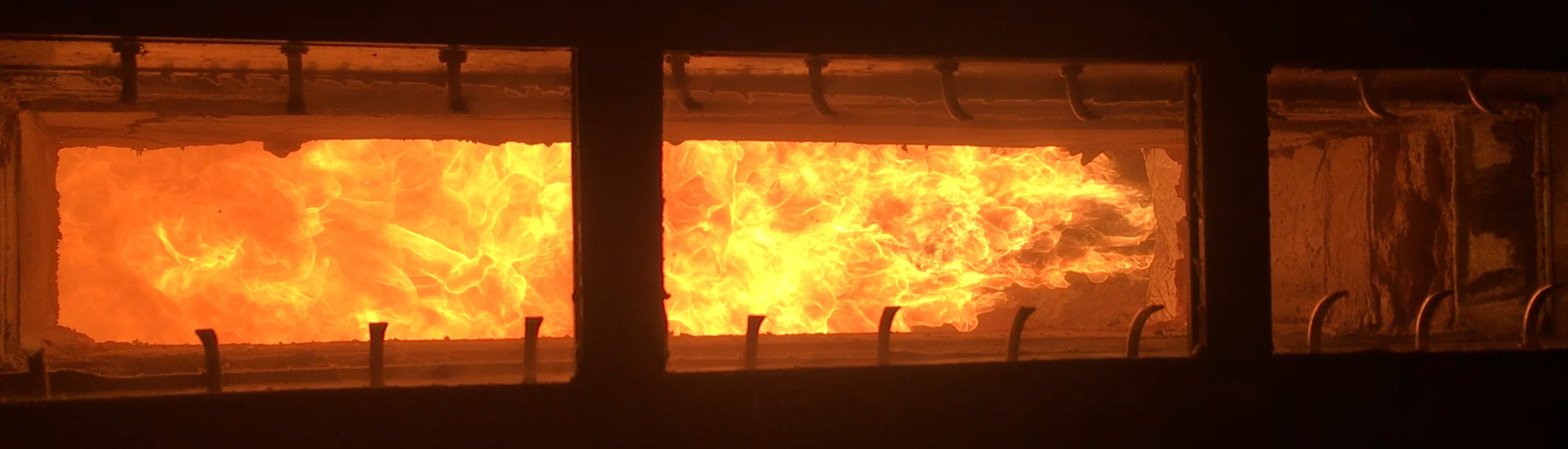
Supercritical CO₂ Power Cycles
US Department of Energy

