Slide 1
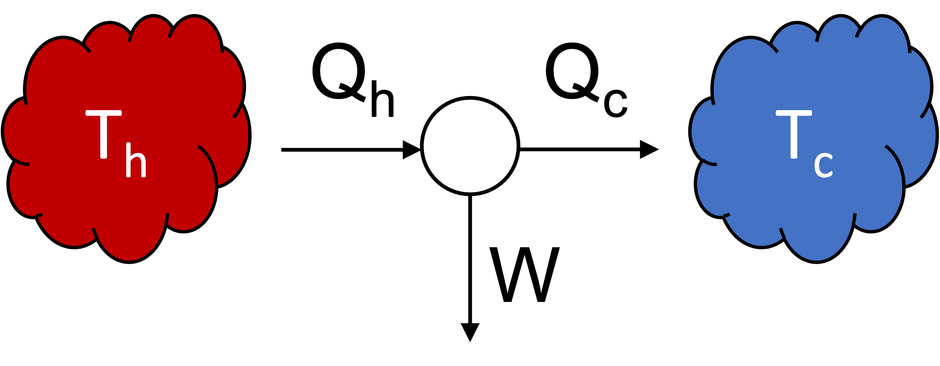
Carnot Efficiency
First Law: energy balance, in = out
Second Law: reversible heat transfer

Slide 2
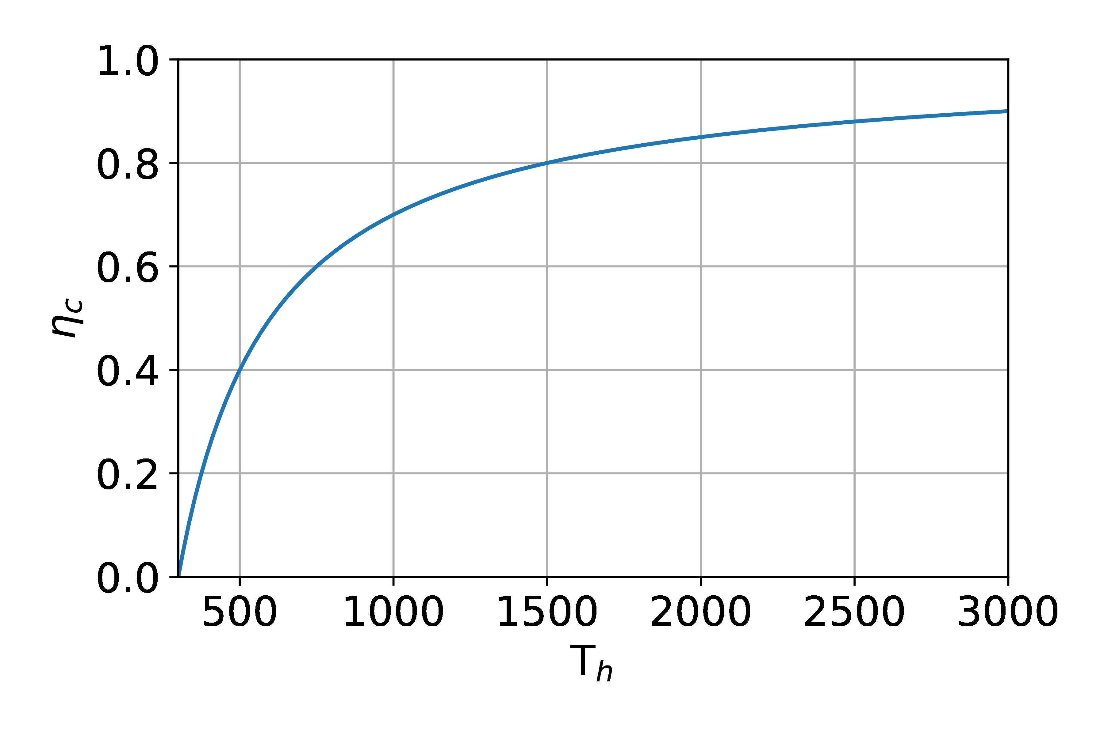
Carnot Efficiency
T_{C} =300 (K)
T_{H} (K)

